Slide 1

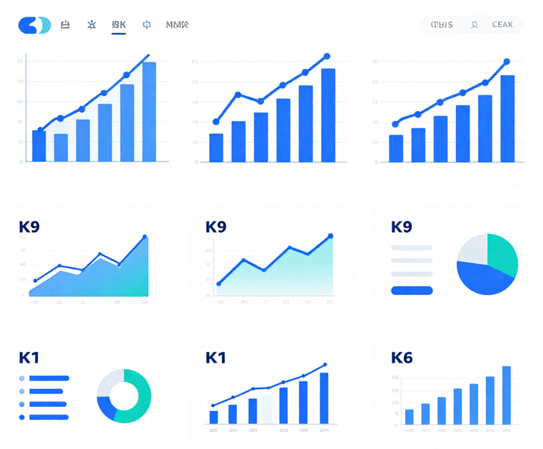

Data Analytics Internship
2024
Sales &
Financial
Dashboard
Data Analytics Internship Project | Elevate Labs
Presented by:
Iram Qureshi
Microsoft Power BI | Superstore Dataset
01/

Slide 2






Project
Objectives
01
02
03
04
Analyze sales trends and patterns over time.
Monitor Sales,Profit,Quantity And Profit Margin
Compare perfor,ance across regions,categories, and sub-categories
Use dashboard insights to support data driven business decisions
02/

Slide 3
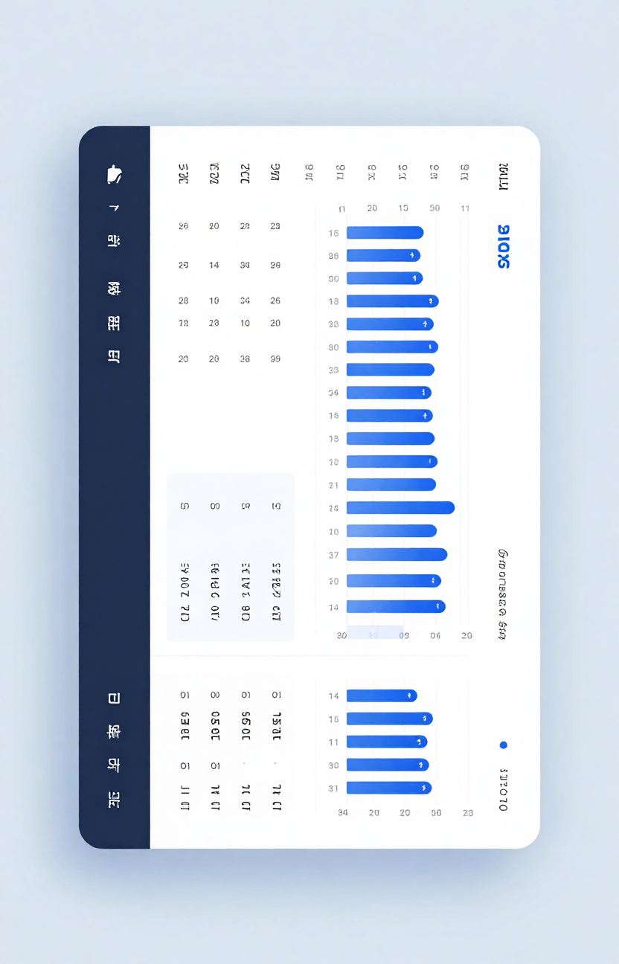
Dataset Overview
The Superstore Sales Dataset contains retail sales transaction data used to analyze business performance. It includes information about orders, customers, products, regions, sales, profit, quantity, discount, and shipping. The dataset was imported into Microsoft Power BI to create an interactive business dashboard.
03/

Slide 4
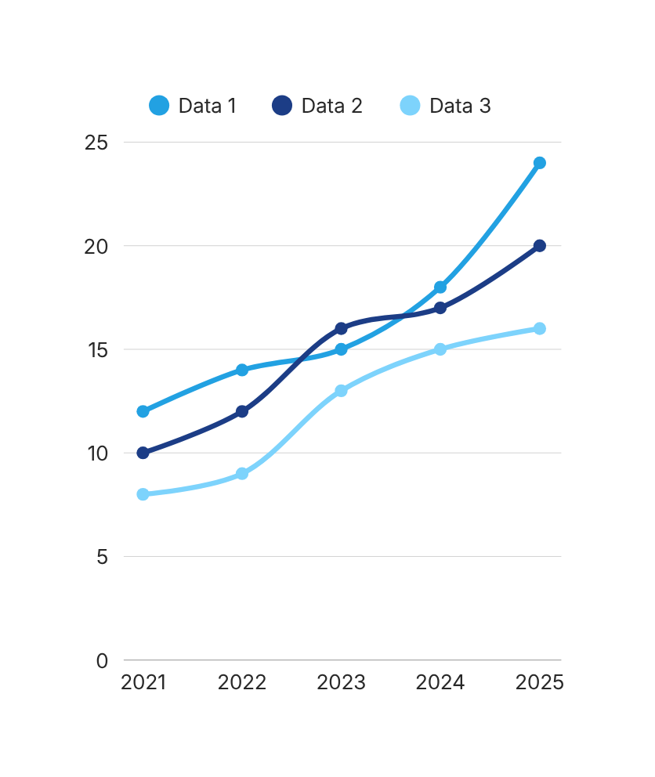
Key Performance Indicators
Total Sales: 203.55K | Total Profit: 88.34K | Quantity: 5K | Profit Margin: 43.4%
These KPIs summarize the overall business performance and help stakeholders evaluate sales, profitability, and product volume.
04/

Slide 5
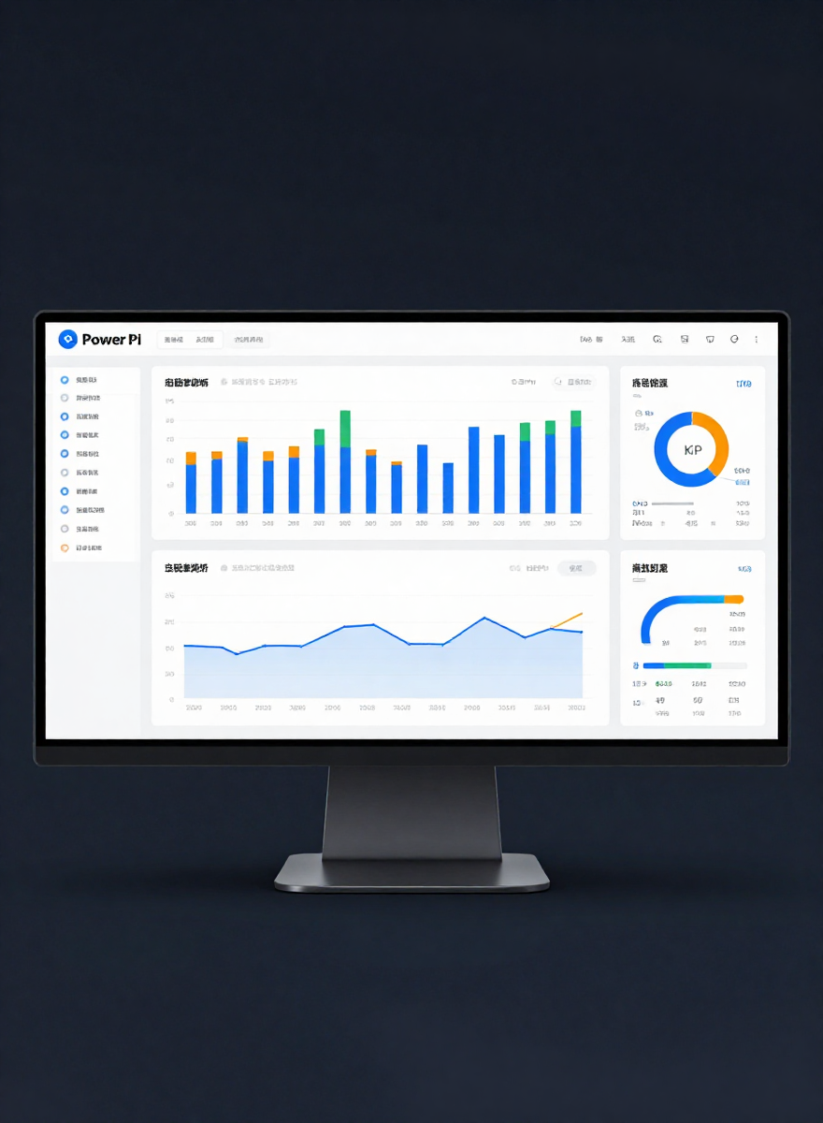
Dashboard
Visualizations
The interactive Power BI dashboard presents key business insights through multiple visualizations:
• Sales Trend Over Time — shows how sales change over time.
• Sales by Category — compares sales across product categories.
• Profit by Region — compares profitability across regions.
• Sales by Sub-Category — identifies sub-categories with higher sales.
• Interactive Slicers — Year, Region, Category, and Segment allow users to filter the dashboard.
05/

Slide 6
Data Analytics Internship
Conclusion
The Power BI dashboard provides a clear view of overall sales and financial performance. KPI cards summarize important business metrics, while charts help identify trends and compare performance across categories, regions, and sub-categories. Interactive slicers allow stakeholders to explore the data from different perspectives and support data-driven decision-making.
Sales & Financial Performance Dashboard — Power BI
Tools Used: Microsoft Power BI, Canva
Dataset: Superstore Sales Dataset
Presented by:
Iram Qureshi
6/
THANK YOU

